Slide 1


Develop For Her - 4.0
Theme: SECURITY
CODE COUTURE
PES UNIVERSITY, Bengaluru

Slide 2
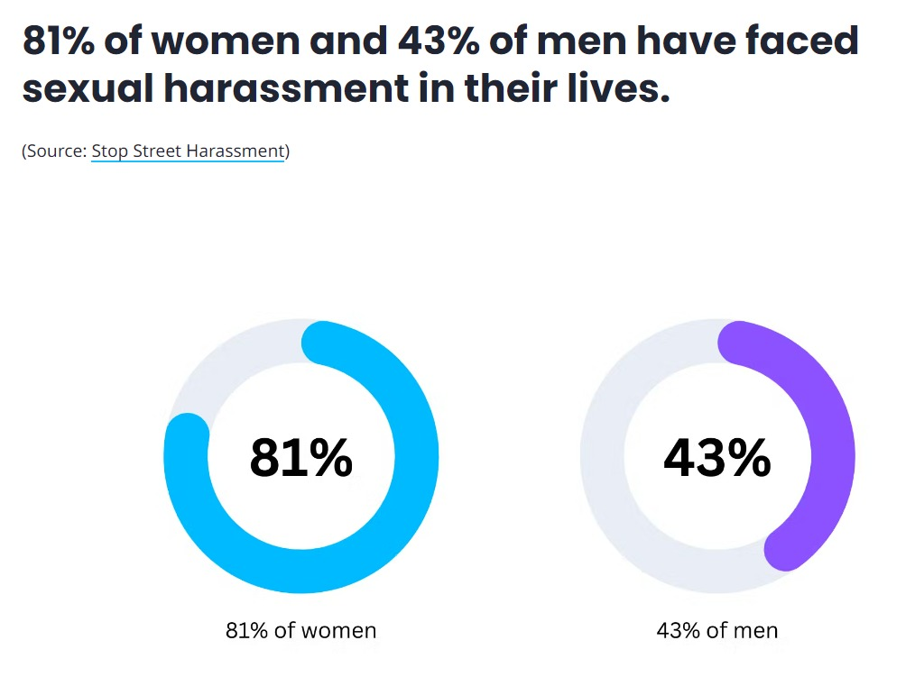

STATISTICS

Slide 3
PROBLEM STATEMENT
Our project aims to tackle the pervasive issue of women's harassment in public and private spaces by leveraging technology for real-time detection and immediate response.
Importance: Harassment is a critical problem affecting women's freedom and safety globally. Fast and effective responses to harassment incidents are crucial in preventing harm and providing a sense of security.
OBJECTIVES:
To develop a system that uses webcam technology for the real-time detection of harassment.
To implement an SOS alert mechanism that notifies authorities instantly upon detection, facilitating prompt intervention.

Slide 4
THE SOLUTION
We propose an AI-powered surveillance system that accesses webcam feeds to monitor and analyze behaviors indicative of harassment. Using machine learning algorithms, the system evaluates live footage for potential threats. Upon detecting harassment, it automatically triggers an SOS signal to the designated authorities, including precise location data for swift action.
This solution directly addresses the need for immediate action in harassment incidents, offering a proactive tool to enhance women's safety.
Expected Outcomes:
Increased prevention and reduction of harassment incidents through deterrence.
Improved safety for women in monitored environments.
Faster response times by authorities to harassment situations

Slide 5
HOW IT WORKS
Process Flow:
1. Captures video from the webcam.
2. Processes each frame: resizes it, converts it to an array, and preprocesses it for the VGG16 model.
3. Extracts features using the VGG16 base model.
4. Predicts the presence of harassment using the loaded model (model.predict) and displays the prediction on the video frame.
5. Continuously updates the Streamlit interface with the live video feed and the overlay text indicating the prediction and its confidence level.
Implementation Plan: Develop and train machine learning models on datasets representing various harassment scenarios. Integrate the detection system with existing security infrastructure. Establish protocols with local authorities for SOS alert responses.

Slide 6
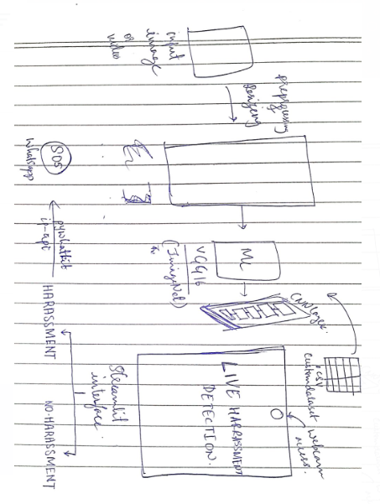
ARCHITECTURE

Slide 7


CUSTOM DATASET
Unsafe work environment
Safe work environment

Slide 8
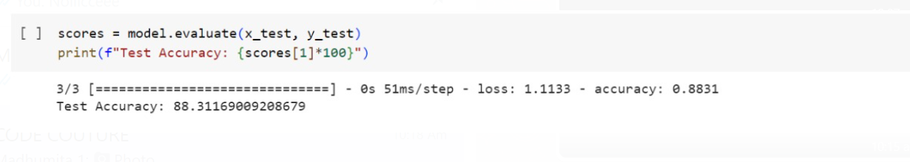
ACCURACY

Slide 9
TECH STACK USED
Programming Languages & Frameworks:
Python (for AI and machine learning)
OpenCV (for video processing and analysis)
Tools & Libraries:
TensorFlow (for developing machine learning models)
Pywhatkit (for whatsapp SOS)
ip-api (to access location coordinates from the ip address )
Streamlit (frontend interface)
System Architecture:
Frontend (user dashboard for monitoring alerts)
Backend (processing and analysis, SOS trigger mechanism)
Machine Learning Models - VGGNet16, CNN (harassment detection).

Slide 10
BUSINESS PROSPECT
Target Audience: Educational institutions, workplaces, public transportation systems, and public spaces where surveillance cameras are already installed.
User Incentive: Enhancing the safety and security of women, reducing liability for institutions, and contributing to a safer community environment.
Solution Feasibility: Leveraging existing webcam infrastructure minimizes setup costs, making it a practical and scalable solution.
Business Applications: The system can be adopted across various sectors as a standard safety protocol to protect women and deter potential harassers.

